Slide 1
Introduction to GIS
through Quantum GIS
Day 2: Technical Stuff Day
offered by Valley Stewardship Network
taught and prepared by Legion GIS, LLC
July 2016

Slide 2
Today’s Technical Stuff…
Spatial Data
--vector vs. raster
--common formats of each category
(remember, this whole GIS thing is just data storage and interpretation)
Coordinate Reference Systems
--needed to correctly interpret the spatial data
(spatial data without a coordinate reference system is as misunderstood as a moody adolescent)

Slide 3

vector data
Stored as discrete vector geometries, called “features”
Three basic types of geometries: point, line, polygon
There are also more complex variations like “multipoint”, or “multipolygon”
An attribute table accompanies the geometries, with one row per feature
The attribute table can have many columns (or “fields”), each containing a piece of information about the feature
In QGIS, use the Identify tool to quickly view all attributes for a given feature

Slide 4
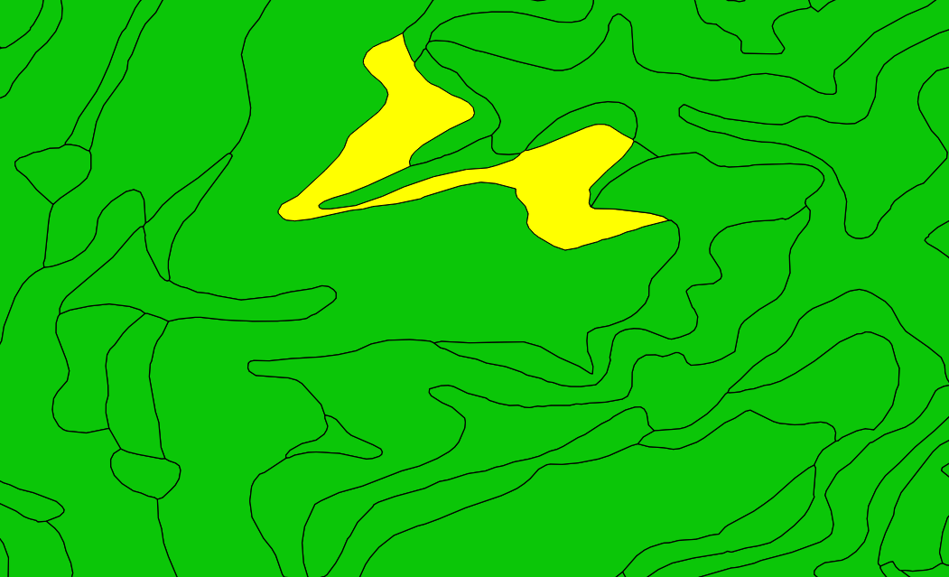
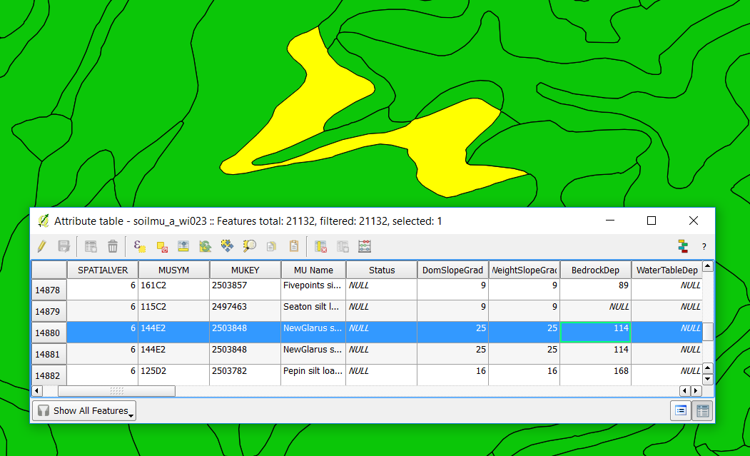
example of vector data…
the geometry
(these are soil unit polygons)
the attribute table
(these are attributes for each unit)
USDA Soil Survey Geographic Database (SSURGO), Crawford County

Slide 5
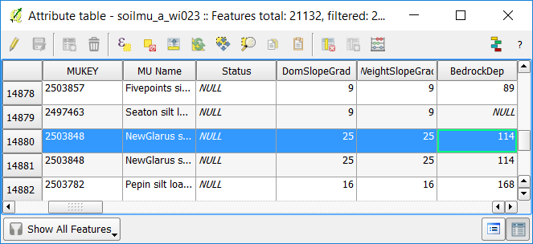
a closer look at the attribute table…
One row per feature, each row has an “object id”

Slide 6
a closer look at the attribute table…
Multiple named columns (fields)

Slide 7
a closer look at the attribute table…
Here is the bedrock depth for this specific soil unit

Slide 8
common vector formats
Delimited Text File
Very simple text file that holds a table structure
First line of the file holds the names of the table columns, each subsequent line holds information for one feature
Often stored as a .csv file, or simply a .txt file
KML or KMZ file (Google Earth)
Stores basic vector data
Limited support for attribute table storage
Easy use view in Google Earth, Google “My Maps”, or QGIS

Slide 9
common vector formats
ESRI Shapefile
Most ubiquitous format (and open because ESRI published the specs a while ago)
Has some technical limitations
10 character field names, blah blah…
Basically the best thing for us to use in QGIS right now
A single shapefile is actually a combination of a few different files:
.shp (this holds the geometry, and is considered the main file)
.shx (this is a fancy indexing thing)
.dbf (this is the attribute table)
.sbn, .cpg, .prj, .qpg, .shp.xml (these may or may not be present, and contribute indexing, projection, metadata, or other information)
Mapping software like QGIS aggregates all these shapefile pieces into one dataset.

Slide 10
common vector formats
ESRI File Geodatabase
Currently, QGIS has read-only support for this format
Holds vector data in “feature classes”
NOT EXCLUSIVELY A VECTOR FORMAT: Can also hold an ESRI raster format, and annotation feature classes (independent labels)
Can enforce “topology” rules—geometric relationships and/or constraints between feature classes

Slide 11

raster data
Information stored in cells (similar to pixels)
The “resolution” of a raster is the real-world size of each cell
For example, in a 30-meter resolution raster, each cell represents a square piece of the ground that is 30m x 30m
Rasters are made up of “bands”, each band has a single value for each cell
Elevation rasters have 1 band, which contains the elevation value of every cell.
Imagery rasters generally contain 3 bands, one each for red, green and blue. When displayed properly, this gives each cell an RGB value (color) to each cell
Use the Identify tool to view the value for any cell in a raster

Slide 12
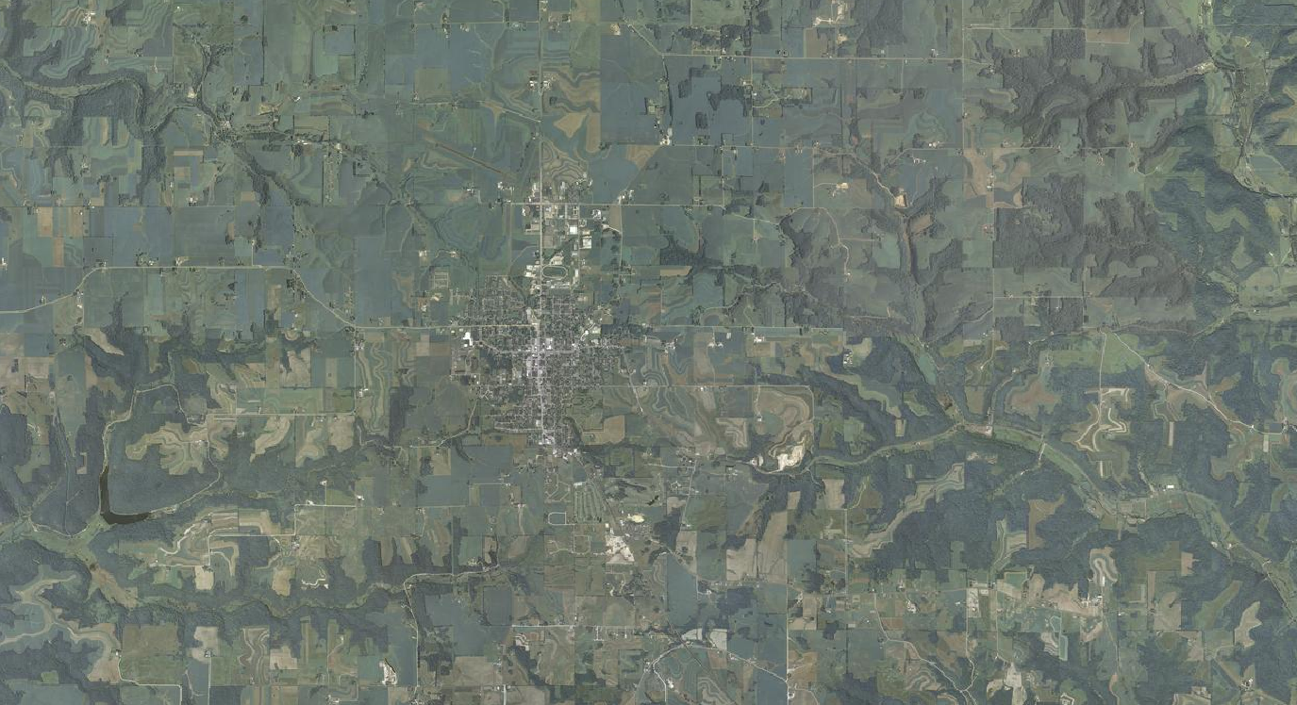
raster data examples
Aerial Imagery (“orthophotos” or “ortho imagery”)
MapQuest Aerial (displayed in QGIS as a Web Map Service via QuickMapServices plugin)

Slide 13

raster data examples
Elevation (“continuous data”)
Vernon Co. 5ft LiDAR-derived Digital Elevation Model (found on WisconsinView)

Slide 14
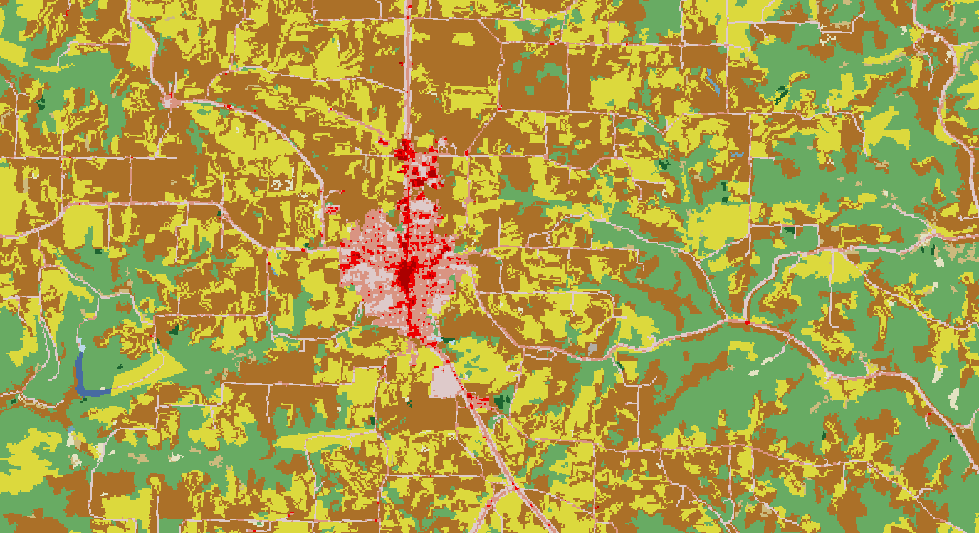
raster data examples
Land Cover (“discrete data”)
USDA National Land Cover Dataset (2011) acquired though NRCS Geospatial Data Gateway

Slide 15
common raster data formats
TIFF, or GeoTIFF
“Tagged Image File Format”, .tif (or .tiff)
Embedded spatial reference or an accompanying .tfw (“world file”)
Common for discrete, or “classified”, data
MrSID
.sid, common for imagery
ESRI ArcInfo Grid
Comes in a folder named for the raster, with files inside. In QGIS you want the file called “hdr.adf”.
Image File
.img, sometimes used for very large raster datasets

Slide 16
just for a little more perspective…
Wikipedia lists 18 different vector formats,
and 13 raster formats. I don’t know what most of them are.

Slide 17

coordinate reference system (CRS)
More ways to refer to them:
spatial reference (SR)
spatial reference system (SRS)
projection (kind of a misnomer as you’ll see)
We’re going to stick with CRS, because that’s what QGIS uses
Where each spatial dataset is defined by its coordinates, a CRS is necessary to correctly interpret those coordinates.

Slide 18



A CRS tells QGIS how to interpret spatial data
=
+
=

Slide 19
A CRS tells QGIS how to interpret spatial data
=
+
=

Slide 20
coordinate reference system (CRS)
Hundreds of different CRS… but,
They all fall into two categories
Geographic Coordinate System (GCS)
Projected Coordinate System (PCS)
And they are all made from the same basic elements…

Slide 21
elements of a CRS
First there is a datum…
…in fact, that’s all you need for a Geographic Coordinate System.
datum
GCS
+
Then a projection, an origin, and type of units are defined…
…and the result is a Projected Coordinate System.
projection,
origin,
units
PCS

Slide 22
elements of a CRS
First there is a datum…
datum

Slide 23
what is a datum?
An abstract model of the earth’s surface, based on mathematical estimations of the earth’s center and the dimensions/shape of the “spheroid”
Latitude and longitude are degree measurements around this surface
Latitude is a North/South measurement
Longitude is an East/West measurement
Let’s consider these coordinates for a moment:
N43° 33' 24” (latitude) and W90° 53’ 21” (longitude)
They actually mark different points on the earth depending on which datum you use to interpret them.

Slide 24
to be more specific…
We only really care about three “datums”
North American Datum 1927, better known as NAD 27
Defined in 1927, you can still find it on USGS topo maps sometimes
North American Datum 1983, better known as NAD 83
Defined in 1983, as with NAD27, optimized to model North America as accurately as possible
World Geodetic Survey 1984, better known as WGS 84
Defined in 1984, used for data collection worldwide
Other notes:
GPS always collect coordinates in WGS84, but you can usually set them to convert those coordinates to NAD83 (or another datum) if you want.
The vast majority of all continental US spatial data uses NAD83, maybe NAD27
You’ll also see HARN NAD83, which is a “statewide regional upgrade of NAD83” (from the NGS NOAA website)

Slide 25
elements of a CRS
First there is a datum…
…in fact, that’s all you need for a Geographic Coordinate System.
datum
GCS

Slide 26
Geographic Coordinate System recap
A GCS interprets coordinates as latitude and longitude
A GCS is entirely based on a single datum
There are only three GCS of which we need to be aware:
NAD27
NAD83
WGS84

Slide 27
elements of a CRS
First there is a datum…
…in fact, that’s all you need for a Geographic Coordinate System.
datum
GCS
+
projection,
origin,
units
Then a projection, an origin, and type of units are defined…
projection,
origin,
units

Slide 28
what is a projection?
A mathematical formula to “flatten out” the globe in order to make a 2D map
Popular projections you may have heard of…
Mercator
Well, I guess that’s probably about it…
Projections can get pretty wild. https://www.jasondavies.com/maps/transition/

Slide 29
what is an origin?
Just like in algebra, the bottom left corner of a Cartesian grid system
It is defined by a “central meridian” and “latitude of origin” which are included in the CRS
It is used to focus the projection on a specific area, often called a “zone”, of the globe
This is because every projection can only faithfully show a certain portion of the globe (while greatly distorting the rest).

Slide 30
what are units in a CRS?
Usually just feet or meters.
On the Cartesian coordinate system created by the projection, the units are the x,y measurements.
Example coordinates:
725249,95549
Which means X = 725,249 and Y = 95,549
Or 725,249 units EAST and 95,549 units NORTH of the origin.
And in this CRS, units happen to be meters.

Slide 31
elements of a CRS
First there is a datum…
…in fact, that’s all you need for a Geographic Coordinate System.
datum
GCS
+
Then a projection, an origin, and type of units are defined…
…and the result is a Projected Coordinate System.
projection,
origin,
units
PCS

Slide 32
Projected Coordinate System recap
PCS interprets coordinates as an x,y position a Cartesian plane
Units are measured in Feet or Meters (defined by the CRS itself)
A projection is used to “flatten” the globe into a 2-dimensional plane
Like a GCS, every PCS is based on a datum

Slide 33
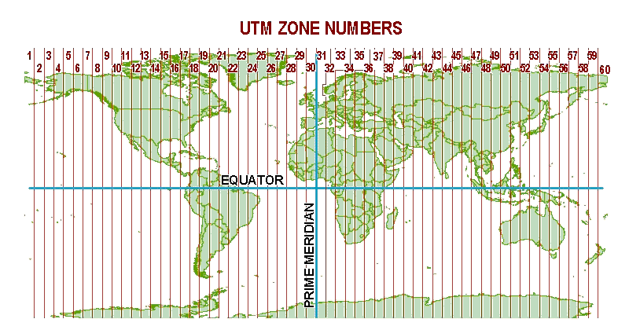
common Projected Coordinate Systems…
UTM Zones (Universal Transverse Mercator )
CRS that uses UTM projection
Use either NAD27, NAD83, or WGS84 datum
All UTM CRS show specific zones
NORTH
UTM Zone 15N
SOUTH
Image from National Geospatial-Intelligence Agency website

Slide 34
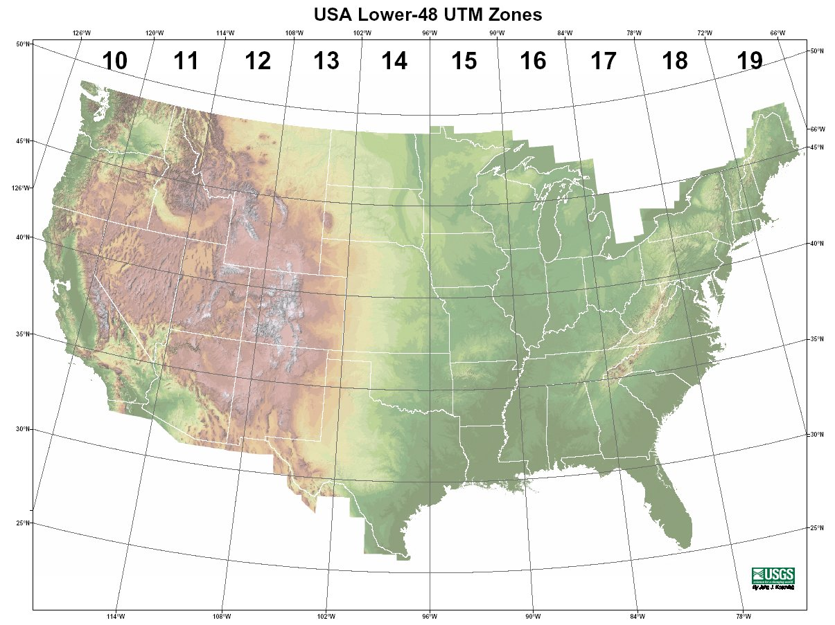
UTM Zones in the continental US
Image from National Park Service

Slide 35
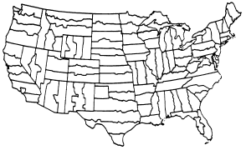
common Projected Coordinate Systems…
State Plane Zones
All of these use NAD83 datum (or NAD83 HARN)
Used for the best/most standard regional representations of states
WI has State Plane North, Central, and South
Image from National Geospatial-Intelligence Agency website

Slide 36
common Projected Coordinate Systems…
Wisconsin County CRS
Each county in WI has its own CRS, and some county data is distributed using these.
You can find all of these CRS stored in projection files at this location:
http://www.wisconsinview.org/research/projection_files/
WGS 84 / Pseudo Mercator
Aka “Web Mercator”, or in ArcMap “Web Mercator (Auxiliary Sphere)”
Used for all web maps (Google Maps, for example)

Slide 37
CRS Summary
Every spatial dataset stores coordinates
A CRS is used to correctly interpret those coordinates
There are two basic types of CRS:
Geographic Coordinate Systems
Interprets coordinates as latitude/longitude
Projected Coordinate Systems
Interprets coordinates as x,y positions within the Cartesian plane created by a projection and origin (as defined by a central meridian and latitude of origin)
Final detail: All CRS have their own EPSG code (a 4-6 digit number) which you may come across

Slide 38
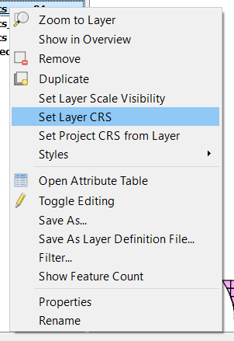
What does this mean for Quantum GIS!?
Two different places a CRS is used:
1: At the Layer level
Each layer must have the correct CRS defined in order for it to properly line up with all the others
If your data has an embedded CRS or an accompanying .prj or .qpj file, you shouldn’t need to do anything when adding it to your project.
However, in many cases you’ll be asked to define the CRS when you add a dataset. All you’re doing is telling QGIS how to interpret your data’s coordinates.
Right-click a layer and select “Set Layer CRS” at any time
When all layers have a correctly defined CRS, you will be happy.

Slide 39
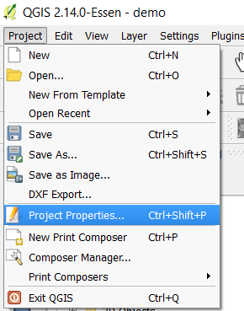
What does this mean for Quantum GIS!?
Two different places a CRS is used:
2: At the Project level
The Project CRS is the one used for the map view
If you are making a map of the entire US, you would want a CRS that shows the whole thing in a pleasing way (Lambert Conformal Conic, for example)
If you are making a map of southwestern Wisconsin, you may want to use State Plane WI South
If you are just examining data, you may simply want to use a GCS (though things will look a little squashed)

Slide 40
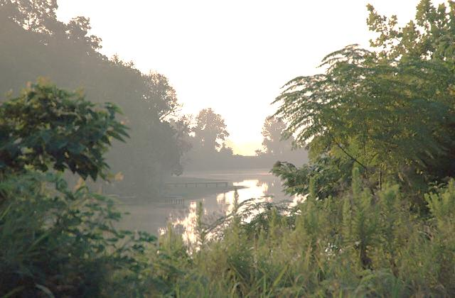
questions and break time…

